Slide 1

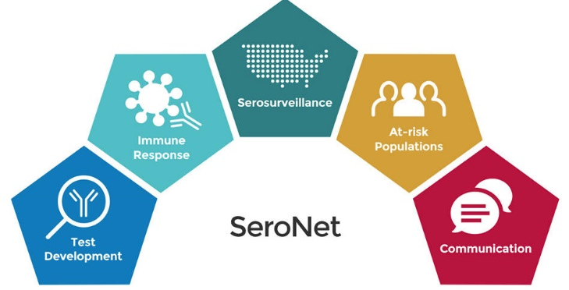
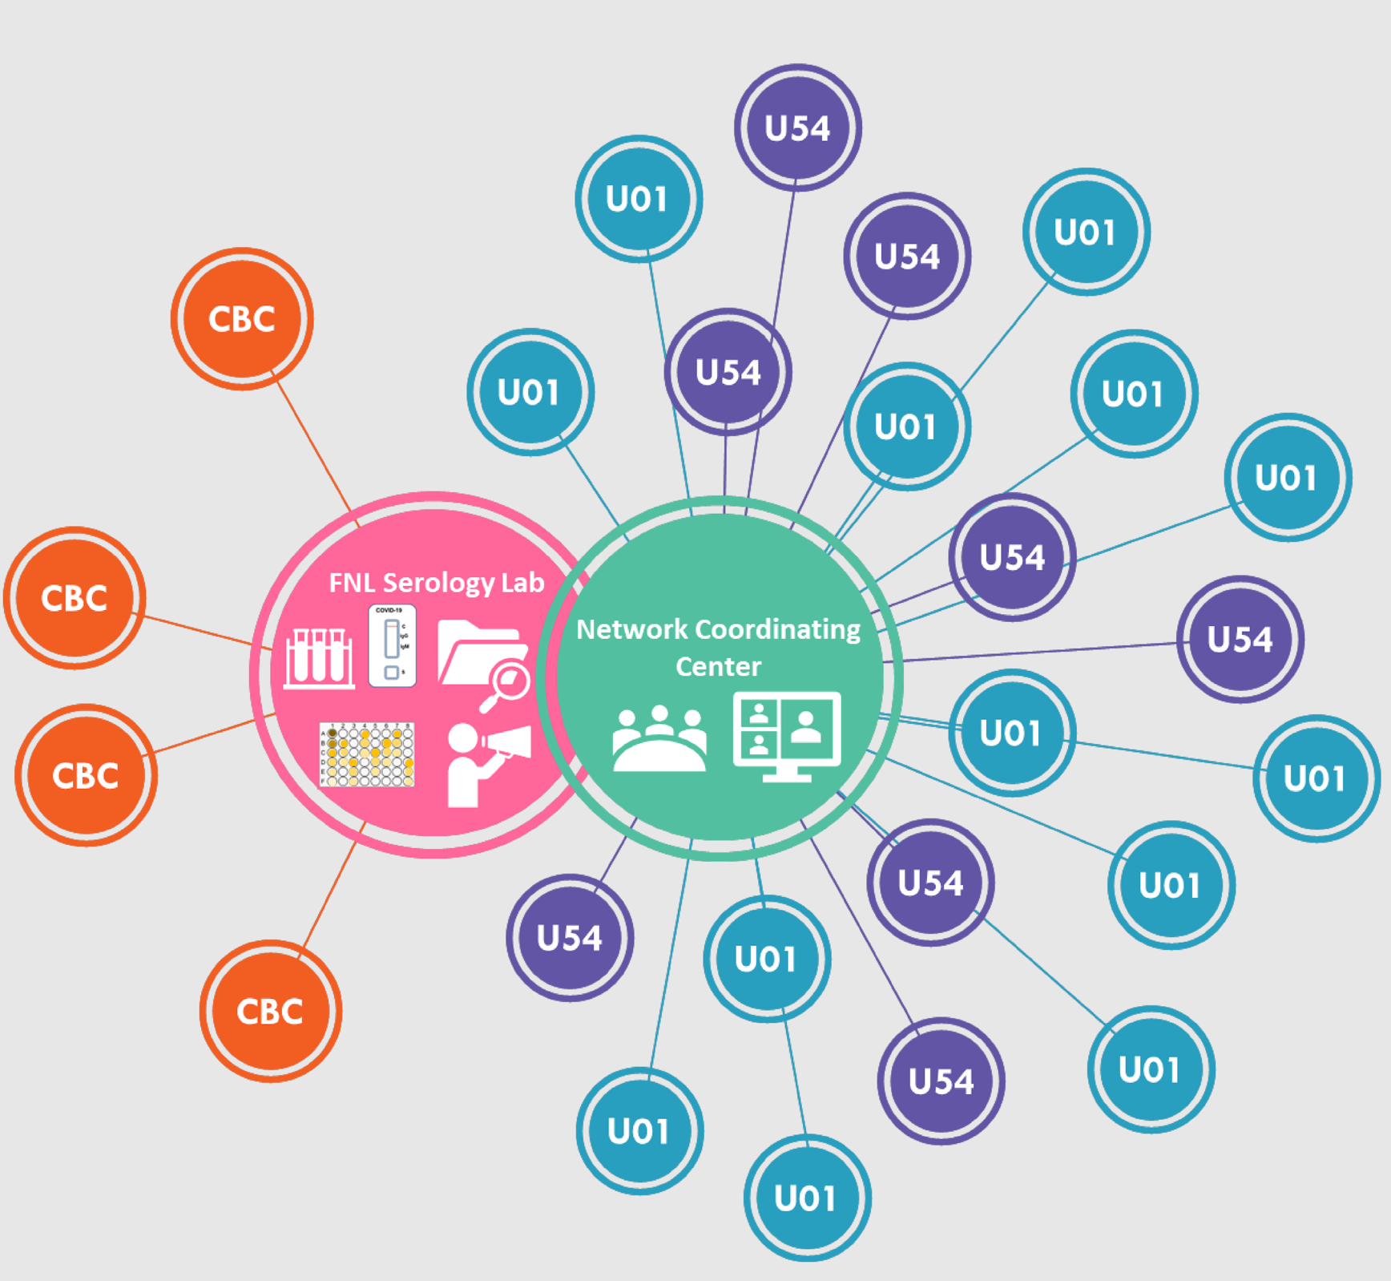
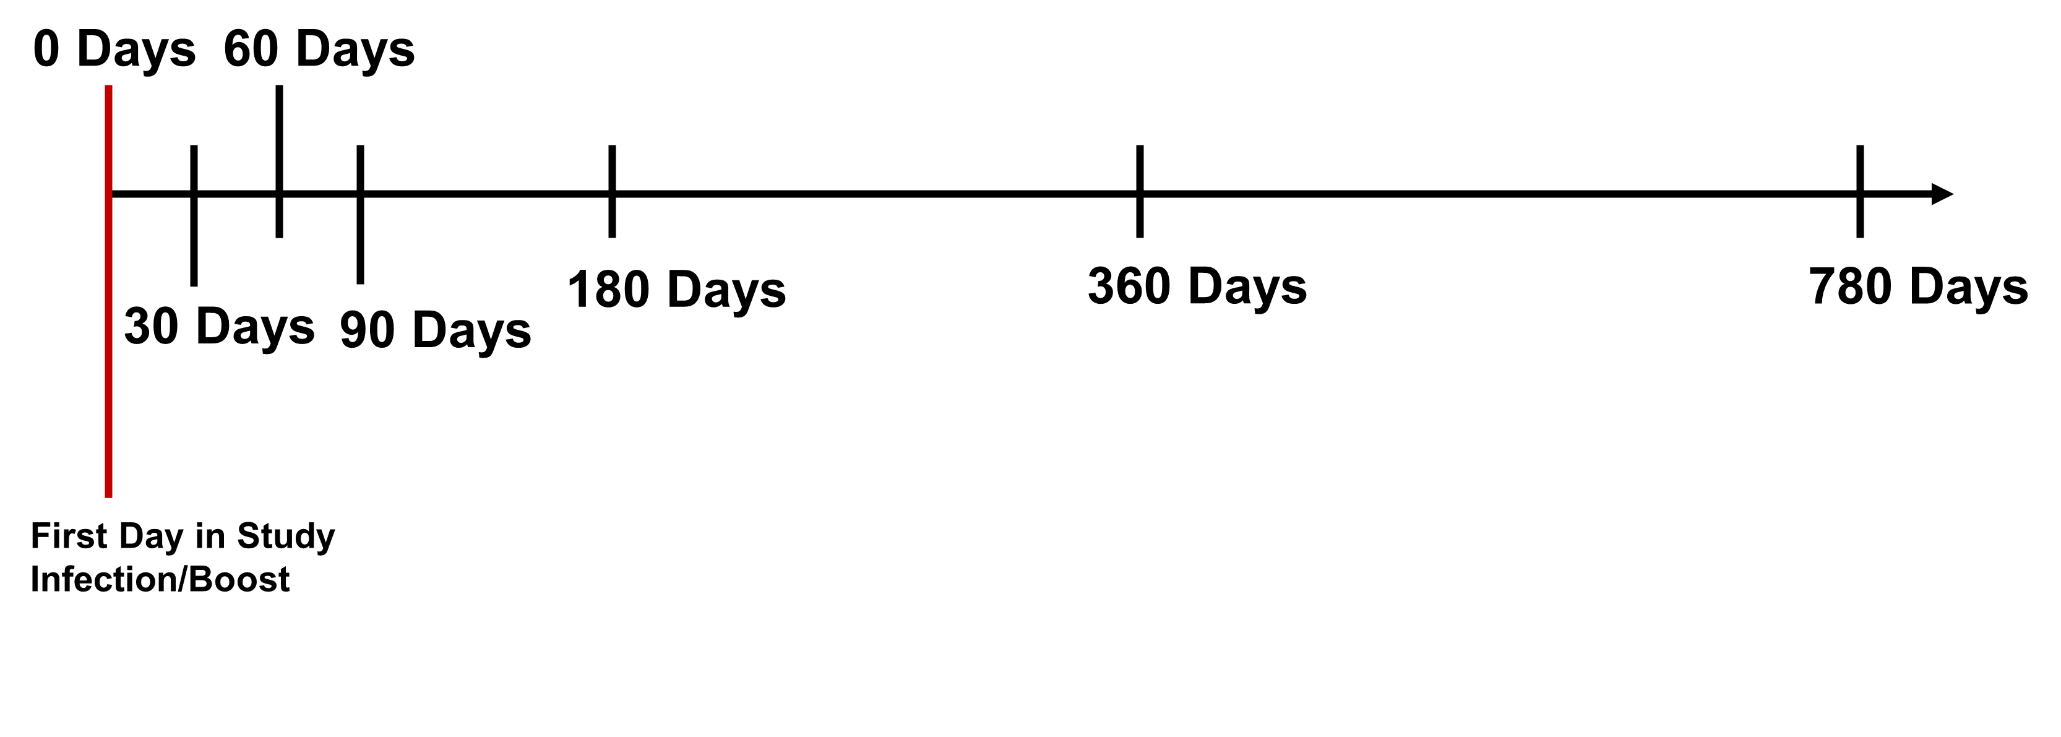
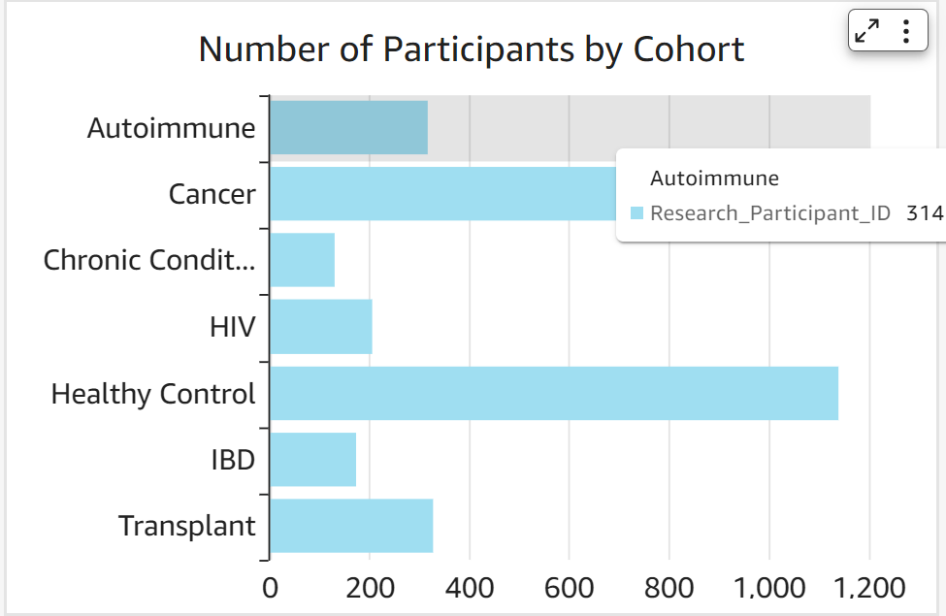
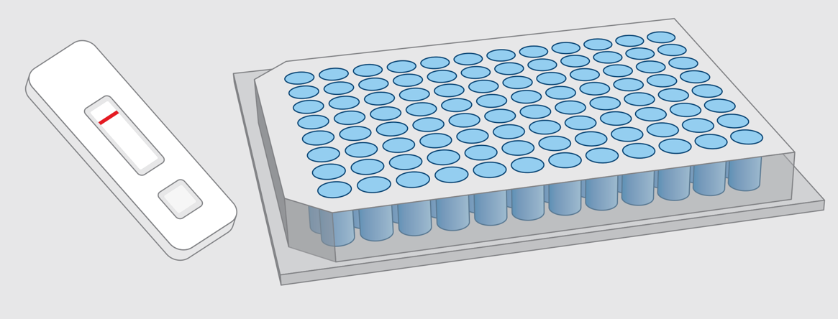
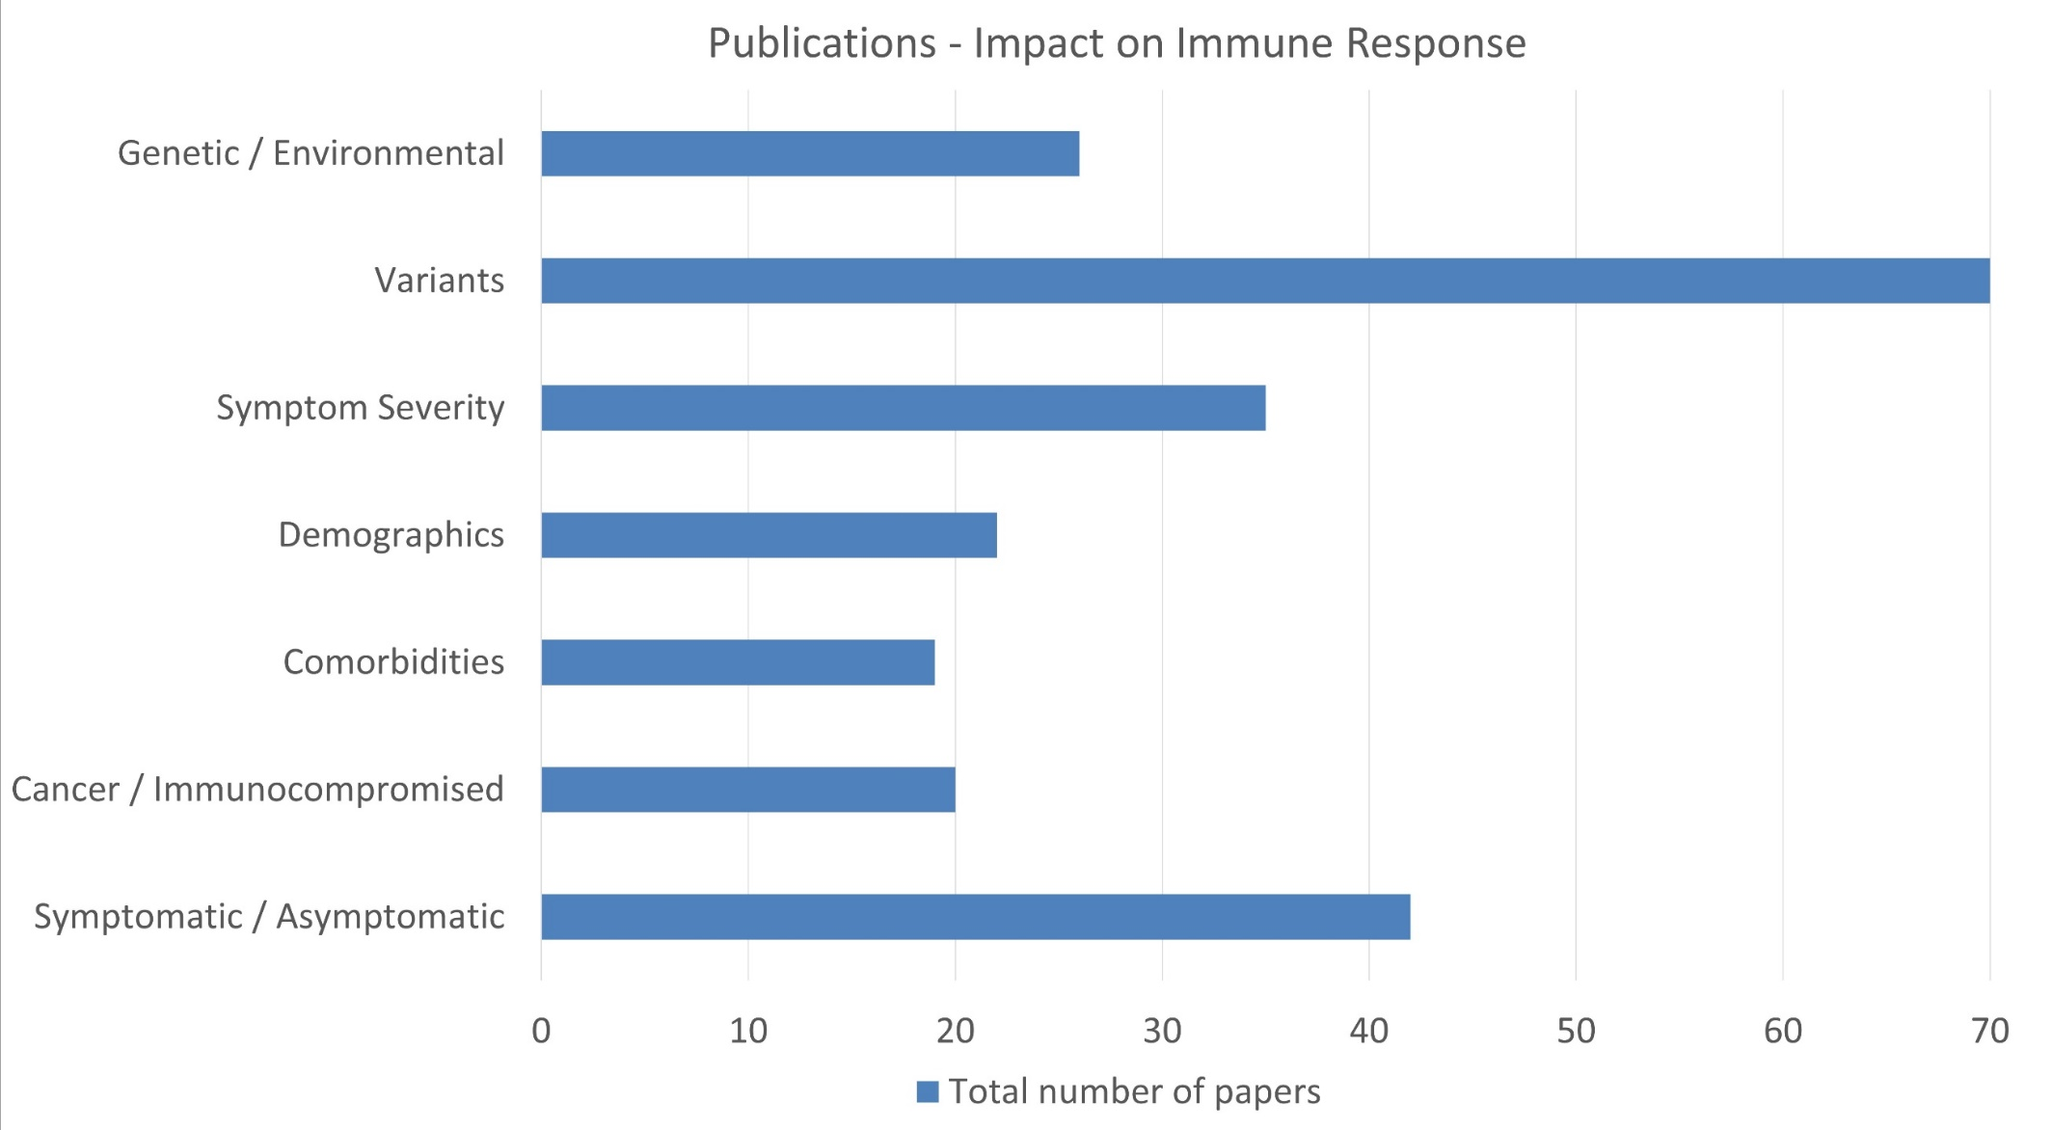
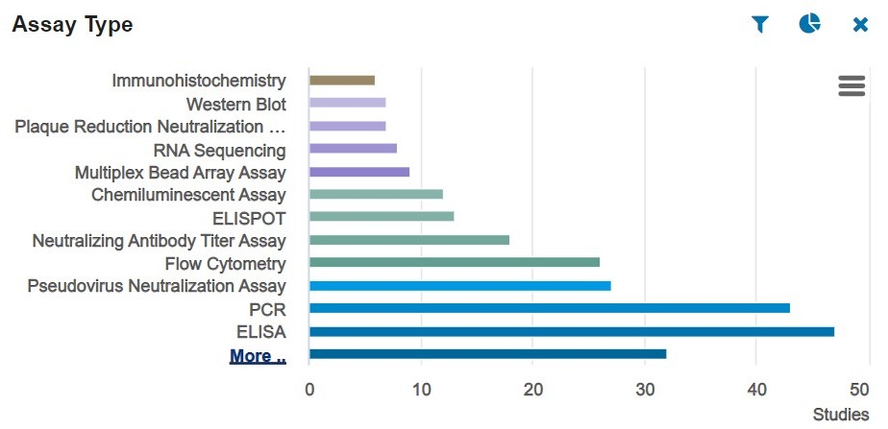
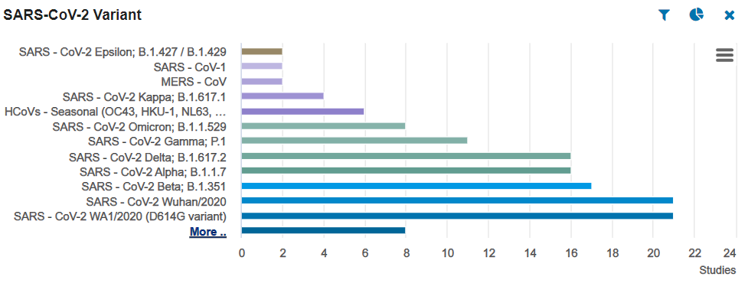
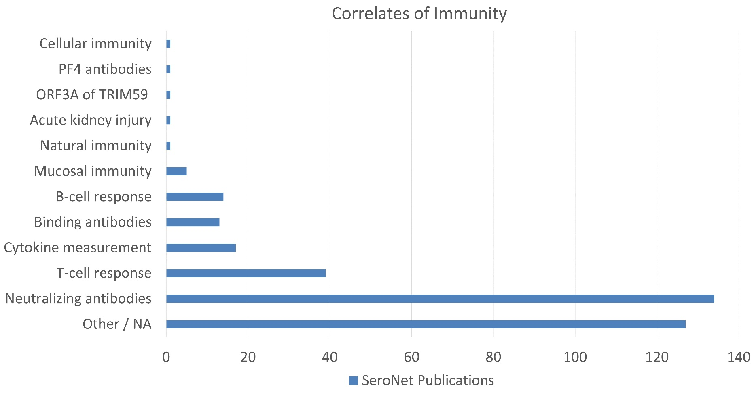
The Serological Sciences Network (SeroNet); the U.S. government’s effort to boost testing capacity and escalate standardized research on immune responses to SARS-CoV-2
Nancy Roche¹, Elaine Freund¹ Tom Hickey¹, Troy Kemp¹, Heidi Hempel¹, Ligia Pinto¹, Michelle Berny-Lang², Jim Cherry³, Samantha Finstad², Juli Klemm², Dinah Singer²
¹Vaccine, Immunity and Cancer Directorate, Frederick National Laboratory for Cancer Research, Frederick, MD 21702
²Center for Strategic Scientific Initiatives, National Cancer Institute, National Institutes of Health, Bethesda, MD, USA.
³Research Technologies Branch, National Institute of Allergy and Infectious Diseases, National Institutes of Health, Rockville, MD 20852
Background and Methods:
The SARS-CoV-2 pandemic created a critical need to conduct team science focused on SARS-CoV-2, in an unprecedented, coordinated fashion at an unprecedented pace¹⁻³
VICD provided high quality serology assays and critical reagents to evaluate seroprevalence and antiviral immune responses
There was an urgent need to collect samples from healthy and at risk populations such as cancer, HIV, and immunocompromised to study their immune response to vaccination and infection
SeroNet: The largest US research network studying the immune response to SARS-CoV-2 and its vaccines
Figure 1: SeroNet structure. The NCI awarded U54 and U01 grants and funding to FNL for VICD Serology Laboratory support and to subcontract Capacity Building Centers (CBCs) to develop technology and provide samples to SeroNet for future research.
Why do some people get sick and others don’t?
Do cancers or autoimmune diseases affect vaccination efficacy?
Why do certain health conditions increase risk of severe illness?
What is the prevalence of SARS-CoV-2 infection across different populations?
Why do some people have severe symptoms and others don’t?
Do COVID-19 vaccines protect against severe infection from different variants?
What factors affect the immune response, and how long does immunity last?
What assays can be developed to diagnosis and predict vaccination or treatment response?
This poster highlights the advances made in SARS-CoV-2 serology standards and team science in SeroNet
Results: Cohorts and Data
Results: SeroNet Publications
SeroNet members have published a total of 331 manuscripts since 2020 with an average Impact factor of 28 overall.
SeroNet members have significantly added to the body of work on correlates of immunity to SARS-CoV-2, publishing on binding and neutralizing antibody response, T cell response, and mucosal immunity.
Results: Resources Available Through SeroNet
Longitudinal Study
SARS-CoV-2 US Serology Standard¹¹
Pooled plasma from 4 donors
Contains IgG and IgM antibodies against SARS-CoV-2 Spike and Nucleocapsid
Calibrated against to the World Health Organization (WHO) International Standard
Validated in 8 different laboratories via:
Automated Chemiluminescence
Commercial Ligand Binding
In-House Developed Ligand Binding
Fluorescence Reduction Neutralization
Validated In-House Serology Assays
ELISA for Spike and Nucleocapsid for different isotypes (IgM, IgG)
Luminex-based Multiplex Assay for 18 Coronaviruses Antigens for IgG including variants and common coronaviruses⁸
Antibody Avidity Assay for Spike IgG
Technology Developments Include
Bacterial extracellular vesicle-based intranasal vaccine against SARS-CoV-2⁴
High dimensional modeling⁵
Humanized mouse model of chronic COVID-19⁶
Multiscale PHATE multimodal signatures of COVID-19⁷
Luminex-based SARS-CoV-2 multiplex serology assay⁸
Rapid on-chip interferon-gamma release assay (IGRA)⁹
Single molecule anti-RBD IgG/IgA array (Simoa)¹⁰
A.
Serum vials collected
B.
PBMC vials collected
Publication Trends Since the Founding of SeroNet
Distributed to >170 laboratories in US and abroad
C.
D.
WHO Standards Manual¹²
Collaborated with the WHO to publish the “WHO Manual for the preparation of reference materials for use as secondary standards in antibody testing, TRS 1043, Annex 2”.
Figure 1. Overview of Longitudinal Specimen Collections. A. Timeline for Collecting Biospecimens: A cohesive collection timepoint strategy was developed to assist analysis efforts. B. Graphical representation of the longitudinal cohorts. C,D. Overview of Longitudinal Specimen Collections by Cohort graphed against days from primary vaccination.
Samples collected by the CBCs are available to SeroNet Investigators
Centralized collection of annotated, well characterized serum, plasma, PBMCs and clinical data
Cohort Clinical Data Collected
Figure 3. SeroNet Publications and Impact Factors by year. Blue, total number of SeroNet-associated manuscripts published that year in PubMed. Red, average impact factor of SeroNet-associated publications published that year.
Cohort
Demographics
Health Conditions
COVID-19 History
Vaccination Data
Treatment History
Biospecimens
Assay Data
Smoking, Drug, Alcohol Use
Future Directions:
ImmPort
Publications on Factors Impacting Immune Response
B and T cell Characterization of Cohorts
Sample sets balanced for vaccination history, time elapsed since last vaccination, and sex from healthy, cancer and immunocompromised cohorts will be selected to represent the longitudinal time course. Validated assays for Spike IgG, Nucleocapsid IgG, and Binding affinity will be used to produce reliable time course immune response curves.
T- Cell assays are being selected to also characterize the humoral immune response in the cancer, healthy and autoimmune cohorts. Neutralization assays will also be performed.
Proteomic and Transcriptomic Analysis
SomaLogic, flow cytometry phenotyping, and RNASeq will be used to investigate markers predicting immune response. Samples from three timepoints, balanced for sex, and well-characterized vaccination histories will be interrogated.
The healthy cohort will be studied first, followed by additional interrogation of cancer and immunocompromised cohorts.
Continued Use of Samples by SeroNet Community
Samples currently being run in the multiplexed, in-solution protein array (MISPA) assay at Arizona State University, which may be the first technology to enable high throughput serological screening for the presence of hundreds of antibodies in thousands of samples simultaneously.
Curated 98 SeroNet publications for public access in ImmPort at https://www.immport.org/home
SeroNet studies in ImmPort currently use 6 (of 15) defined research focuses and features 24 defined assay methods.
SeroNet studies are searchable by research focus, condition/disease, or assay method, and data files are downloadable for data mining.
Figure 4: Number of SeroNet publications by factor impacting immune response. Factors categorized according to SeroNet target questions.
Figure 2. SeroNet publications with SARS-CoV-2 variants in ImmPort. The 98 SeroNet studies uploaded to ImmPort. Searchable by study, cohort and experimental characteristics with graphical displays including (A) viral variants (B) Assays used such as ELISPOT, ELISA, and PCR, RNA seq, bead array assays, and flow cytometry.
Publications on Correlates of Immunity to SARS-CoV-2
Figure 5. Number of SeroNet publications by featured correlates of immunity. Correlates of immunity to the SARS-CoV-2 virus are an essential factor in determining the status of the pandemic/endemic on the population level
References:
1. Figueiredo JC, Hirsch FR, Kushi LH, Nembhard WN, Crawford JM, Mantis N, et al. Organization, and Future Direction of the Serological Sciences Network for COVID-19 (SeroNet) Epidemiologic Cohort Studies. Open Forum Infect Dis. 2022 Apr 27;9(6):ofac171. doi: 10.1093/ofid/ofac171. PMID: 35765315; PMCID: PMC9129196.
2. Karger AB, Brien JD, Christen JM, Dhakal S, Kemp TJ, Klein SL, et al. The Serological Sciences Network (SeroNet) for COVID-19: Depth and Breadth of Serology Assays and Plans for Assay Harmonization. mSphere. 2022 Aug 31;7(4):e0019322. doi: 10.1128/msphere.00193-22. Epub 2022 Jun 15. PMID: 35703544; PMCID: PMC9429934.
3. Pinto LA, Shawar RM, O'Leary B, Kemp TJ, Cherry J, Thornburg N, et al. A Trans-Governmental Collaboration to Independently Evaluate SARS-CoV-2 Serology Assays. Microbiol Spectr. 2022;10(1):e0156421.
4. Jiang L, Driedonks TAP, Jong WSP, Dhakal S, Bart van den Berg van Saparoea H, Sitaras I, et al. A bacterial extracellular vesicle-based intranasal vaccine against SARS-CoV-2 protects against disease and elicits neutralizing antibodies to wild-type and Delta variants. J Extracell Vesicles. 2022 Mar;11(3):e12192. doi: 10.1002/jev2.12192. Erratum in: J Extracell Vesicles. 2022 May;11(5):e12219. PMID: 35289114; PMCID: PMC8920961.
5. Luke RA, Kearsley AJ, Pisanic N, Manabe YC, Thomas DL, Heaney CD, Patrone PN. Modeling in higher dimensions to improve diagnostic testing accuracy: Theory and examples for multiplex saliva-based SARS-CoV-2 antibody assays. PLoS One. 2023 Mar 13;18(3):e0280823. doi: 10.1371/journal.pone.0280823. PMID: 36913381; PMCID: PMC10010503.
6. Sefik E, Israelow B, Mirza H, Zhao J, Qu R, Kaffe E, et al. A humanized mouse model of chronic COVID-19. Nat Biotechnol. 2022 Jun;40(6):906-920. doi: 10.1038/s41587-021-01155-4. Epub 2021 Dec 17. PMID: 34921308; PMCID: PMC9203605.
7. Kuchroo M, Huang J, Wong P, Grenier JC, Shung D, Tong A, et al. Multiscale PHATE identifies multimodal signatures of COVID-19. Nat Biotechnol. 2022 May;40(5):681-691. doi: 10.1038/s41587-021-01186-x. Epub 2022 Feb 28. PMID: 35228707; PMCID: PMC10015653.
8. Roy DR, Kemp TJ, Haynesworth K, Loftus SA, Pinto LA. Development, Validation, and Utilization of a Luminex-Based SARS-CoV-2 Multiplex Serology Assay. Microbiol Spectr. 2023 Mar 16;11(2):e0389822. doi: 10.1128/spectrum.03898-22. Epub ahead of print. PMID: 36927068; PMCID: PMC10100979.
9. Ning B, Chandra S, Rosen J, Multala E, Argrave M, Pierson L, Evaluation of SARS-CoV-2-Specific T-Cell Activation with a Rapid On-Chip IGRA. ACS Nano. 2023 Jan 3;17(2):1206–16. doi: 10.1021/acsnano.2c09018. Epub ahead of print. PMID: 36595218; PMCID: PMC9878992.
10. Thomas SN, Karger AB, Altawallbeh G, Nelson KM, Jacobs DR Jr, Gorlin J, Barcelo H, Thyagarajan B. Ultrasensitive detection of salivary SARS-CoV-2 IgG antibodies in individuals with natural and COVID-19 vaccine-induced immunity. Sci Rep. 2022 May 25;12(1):8890. doi: 10.1038/s41598-022-12869-z. PMID: 35614113; PMCID: PMC9132168.
11. Kemp TJ, Quesinberry JT, Cherry J, Lowy DR, Pinto LA. Selection, Characterization, Calibration, and Distribution of the U.S. Serology Standard for Anti-SARS-CoV-2 Antibody Detection. J Clin Microbiol. 2022;60(11):e0099522.
12. WHO. WHO manual for the establishment of national and other secondary standards for antibodies against infectious agents focusing on SARS-CoV2. 01/30/2022.
Acknowledgements:
Patrick Breads, Jennifer Rubenstein, Alexander Liu, Renuka Vepachedu, David Abraham, Casey Dagnall, John Otridge, Anjan Purkayastha, Amy Hutchinson, Bo Park, Marissa Blackburn, Jimmie Bullock, Deb Hope, The CBC’s led by Carlos Cordon-Cardo & Viviana Simon at Icahn School of Medicine at Mount Sinai, Peter Gregersen & Jim Crawford at Feinstein-Northwell, Amy Karger & Bharat Thyagarajan at UMN and Joshua Labaer at ASU.
This project has been funded in whole or in part with Federal funds from the National Cancer Institute, National Institutes of Health, under Contract No. 75N91019D00024. The content of this publication does not necessarily reflect the views or policies of the Department of Health and Human Services, nor does mention of trade names, commercial products, or organizations imply endorsement by the U.S. Government.
Frederick National Laboratory is a Federally Funded Research and Development Center operated by Leidos Biomedical Research, Inc., for the National Cancer Institute

